Slide 1
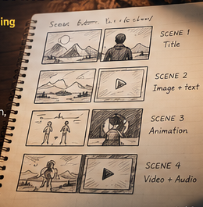
BCA • MULTIMEDIA
STORYBOARDING,
COMBINING &
SYNCHRONISATION
OF MULTIMEDIA
Presented by: Parray Mehran Gulzar
Roll No.: 2606027 • BCA First Year
PLAN
INTEGRATE
SYNC
01 / 09

Slide 2
01 • PLAN THE EXPERIENCE
02
What is storyboarding?
A visual blueprint for a multimedia project.
It arranges sketches or frames in sequence to show what appears on screen, what happens next, and where sound or motion belongs.
PLAN
VISUALISE
CHECK
Define the story
Sketch each scene
Fix gaps early
KEY IDEA • Plan first, produce second.

Slide 3
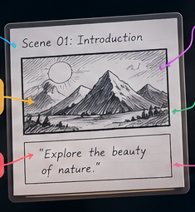
02 • BUILD A USEFUL PLAN
03
Anatomy of a storyboard
FRAME & SCENE
Number each panel and name the scene.
VISUAL SKETCH
Show layout, action and focal point.
TEXT / CAPTION
Write on-screen words or dialogue.
AUDIO NOTES
Mark narration, music and sound effects.
TIMING / MOTION
Note duration, transitions and movement.

Slide 4
03 • FROM IDEA TO FRAMES
04
Six steps in storyboarding
01
Define the goal
02
Write the script
03
Split into scenes
Purpose + audience
Key points + narration
One clear idea per frame
04
Sketch the frames
05
Add timing + audio
06
Review + revise
Plan layout and action
Music, effects, duration
Check sequence and clarity
A good storyboard is clear enough for another person to follow.

Slide 5
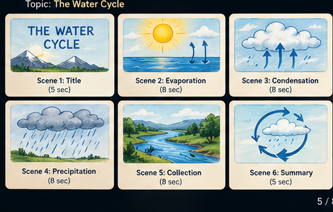
04 • A STORYBOARD IN ACTION
05
Example: The water cycle
01 EVAPORATION
Sun heats water
02 CONDENSATION
Clouds form
03 PRECIPITATION
Rain falls
04 COLLECTION
Water gathers again
Narration and animation follow the same sequence.

Slide 6
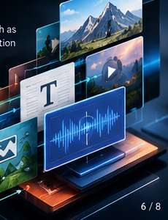
05 • MAKE MEDIA WORK TOGETHER
06
Combining multimedia
Integration brings different media into one coherent experience.
• Text — titles, labels and explanations
• Images / graphics — show objects and ideas
• Audio — narration, music and sound effects
• Video — demonstrate real events
• Animation + controls — explain motion and invite interaction
ONE COHERENT EXPERIENCE

Slide 7
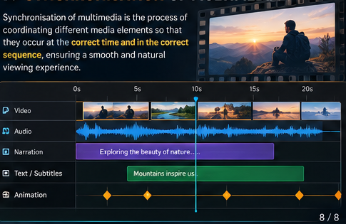
06 • PRODUCTION WORKFLOW
07
How the elements are combined
01
02
03
04
05
06
PLAN
›
COLLECT
›
EDIT
›
INTEGRATE
›
DESIGN
›
TEST
Choose content
Gather / create media
Improve quality
Arrange in software
Consistent layout
Check playback + controls
QUALITY CHECK
Compatible formats • balanced volume • readable text • working controls

Slide 8
07 • TIMING IS EVERYTHING
08
Synchronisation of multimedia
Synchronisation coordinates media so events happen at the right time and in the right order.
EXAMPLE TIMELINE
• Audio matches video and lip movement.
• Narration explains visuals as they appear.
• Subtitles align with spoken dialogue.
• Sound effects match actions on screen.
VIDEO
AUDIO
CAPTIONS
ANIMATION
A shared timeline makes timing errors easier to spot.

Slide 9
08 • PUT IT INTO PRACTICE
09
Types, methods & final takeaway
TYPES OF SYNCHRONISATION
COMMON METHODS
• Audio–video: speech matches the picture
• Audio–animation: sound follows movement
• Subtitle timing: captions match dialogue
• Temporal: events occur in the correct order
• Timeline-based — place media on a shared timeline
• Event-based — a click or action triggers media
• Time-based — schedule an event at a set time
• Frame-based — coordinate action with video frames
REMEMBER
STORYBOARD = PLAN • COMBINE = INTEGRATE • SYNCHRONISE = ALIGN TIMING
THANK YOU • 09

